Slide 1

Web Technologies Project
Project Name : Shutter & Soul
Team:
Y.Siddhartha Reddy(22WU0105028) DS-B
V.Neha (22WU0101124) CSE-B
T.Varshith (22WU0105025) DS-B

Slide 2
Problem Statement
Develop a striking photography portfolio website named 'Shutter & Soul' to exhibit an array of captivating visual narratives. Ensure seamless user experience with intuitive navigation, dynamic image galleries, and responsive design. Emphasize the photographer's distinct aesthetic and professional prowess, inviting potential clients to engage and connect effortlessly.

Slide 3
Solution
Develop 'Shutter & Soul' using HTML, CSS, and JavaScript for frontend, with PHP and MySQL for backend. Curate stunning photographs, ensure responsiveness, and optimize for SEO. Deploy on a reliable hosting platform, maintain regularly, and promote across social media for client engagement and growth.

Slide 4
Technologies Used
HTML
CSS
JAVASCRIPT
PHP
SQL

Slide 5
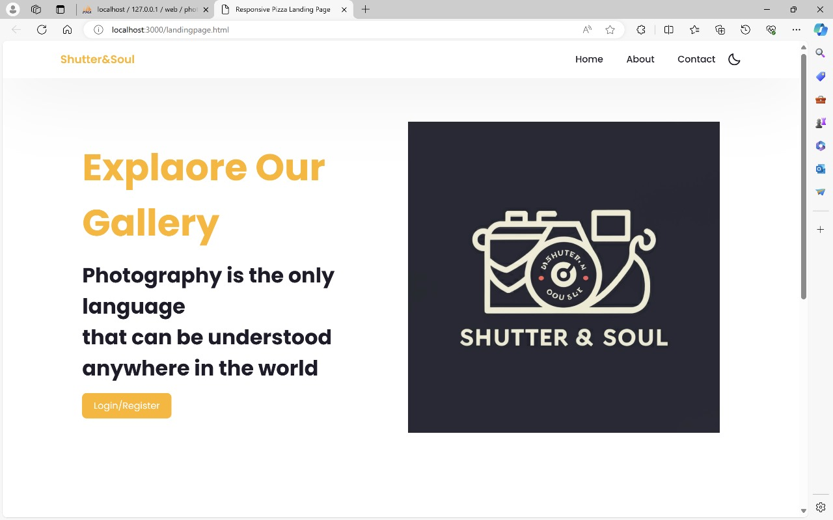
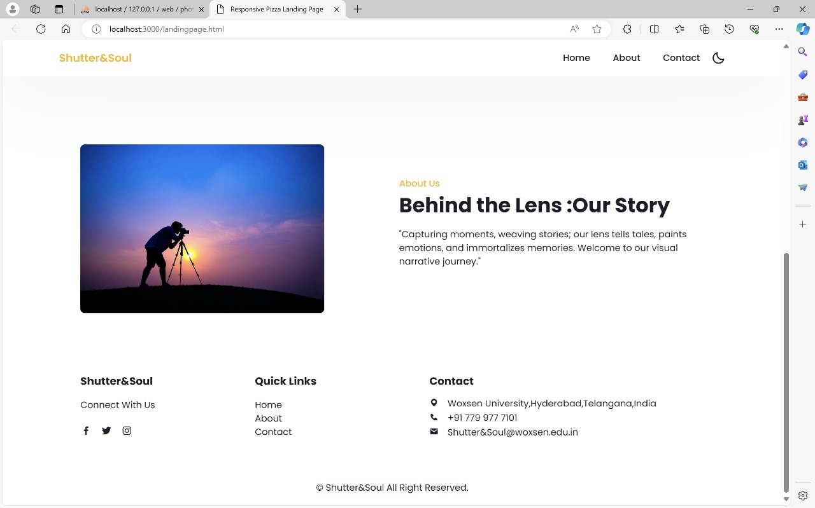
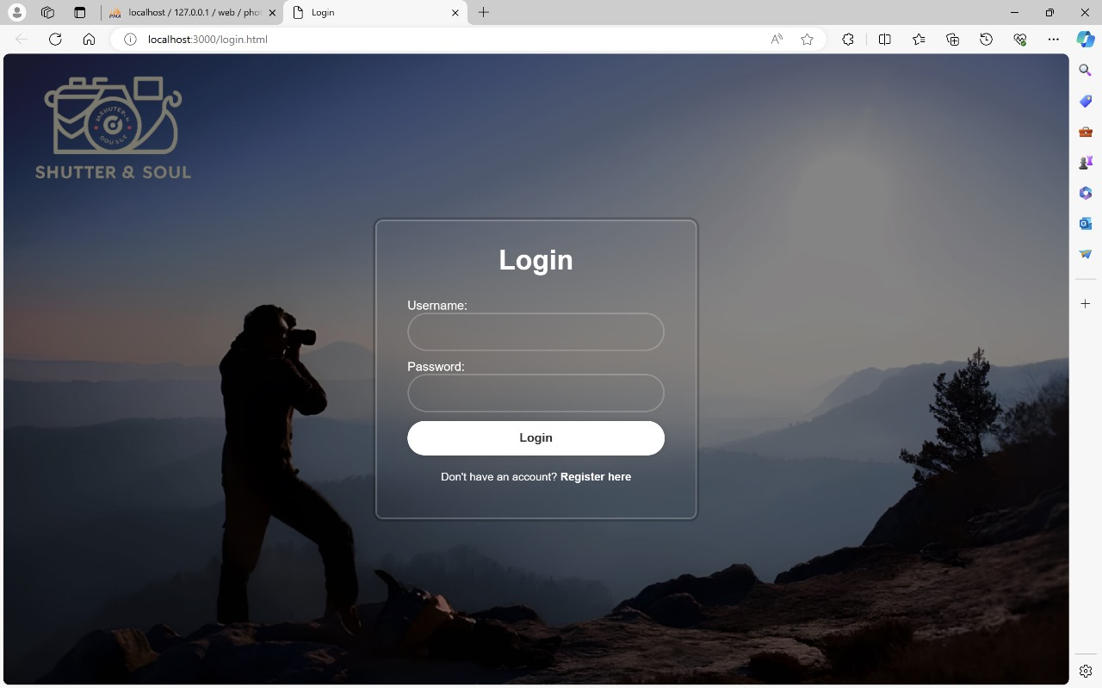
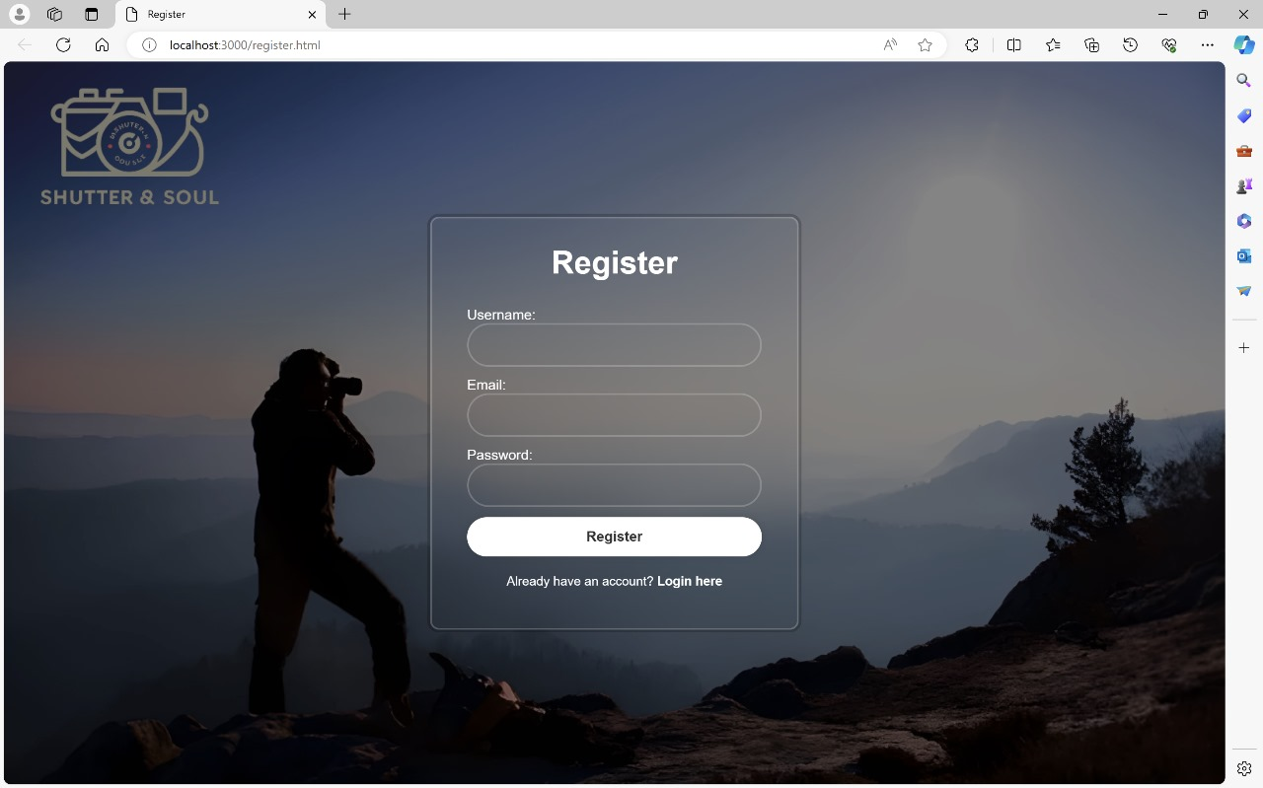
Web application screen shots

Slide 6
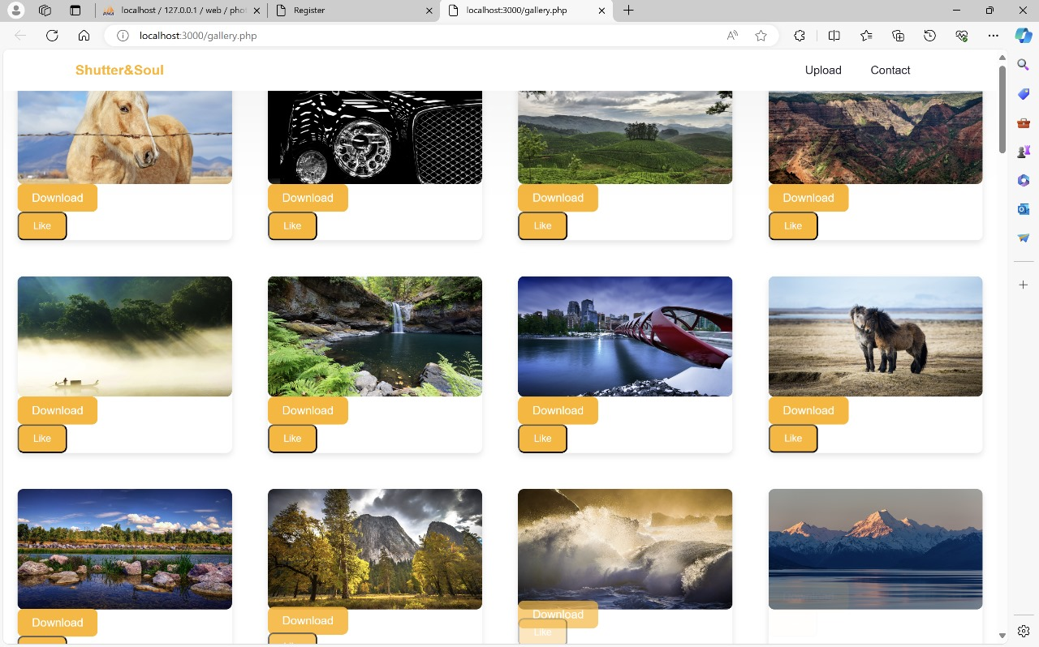
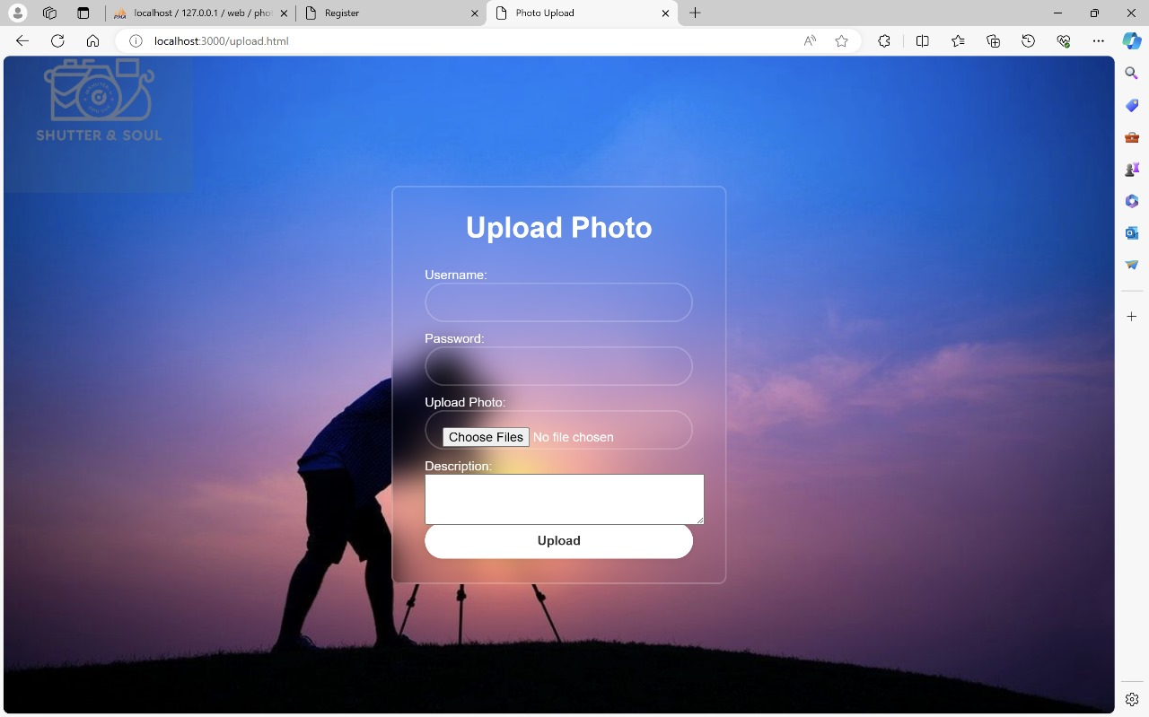
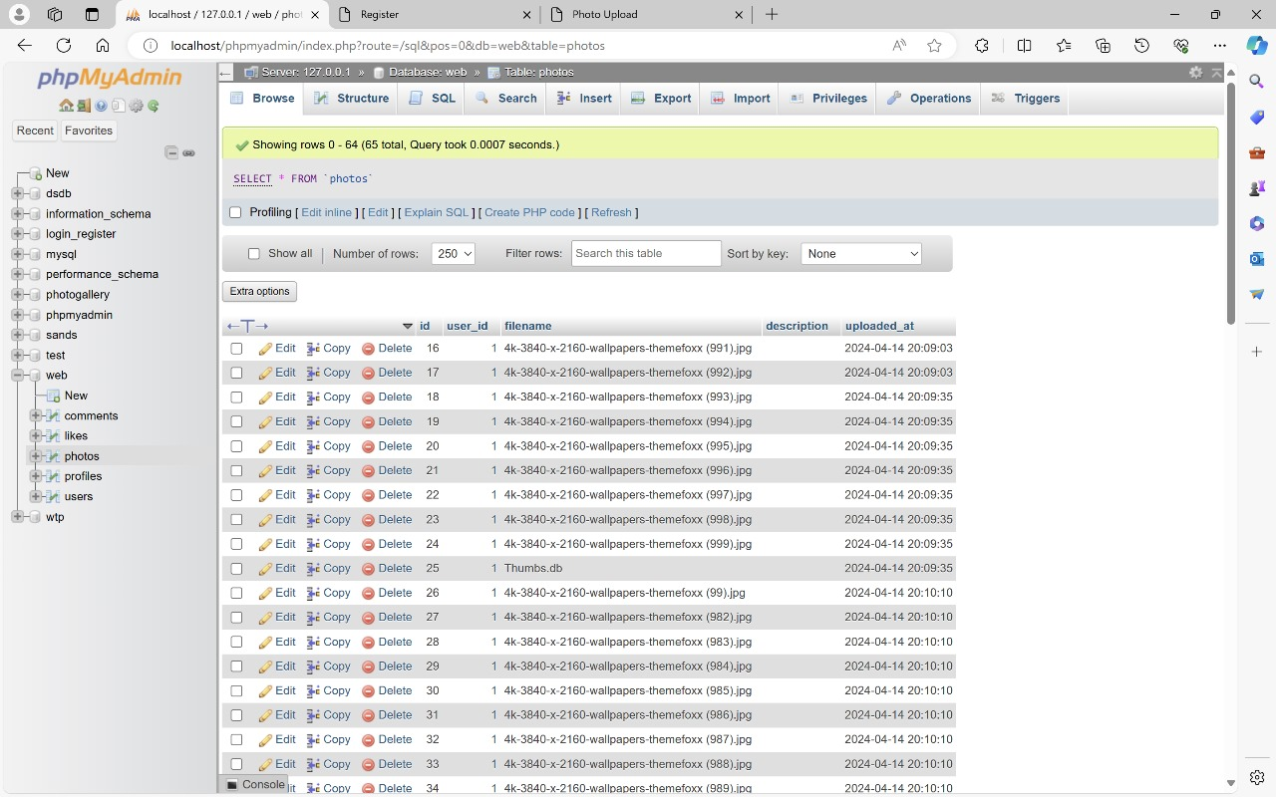
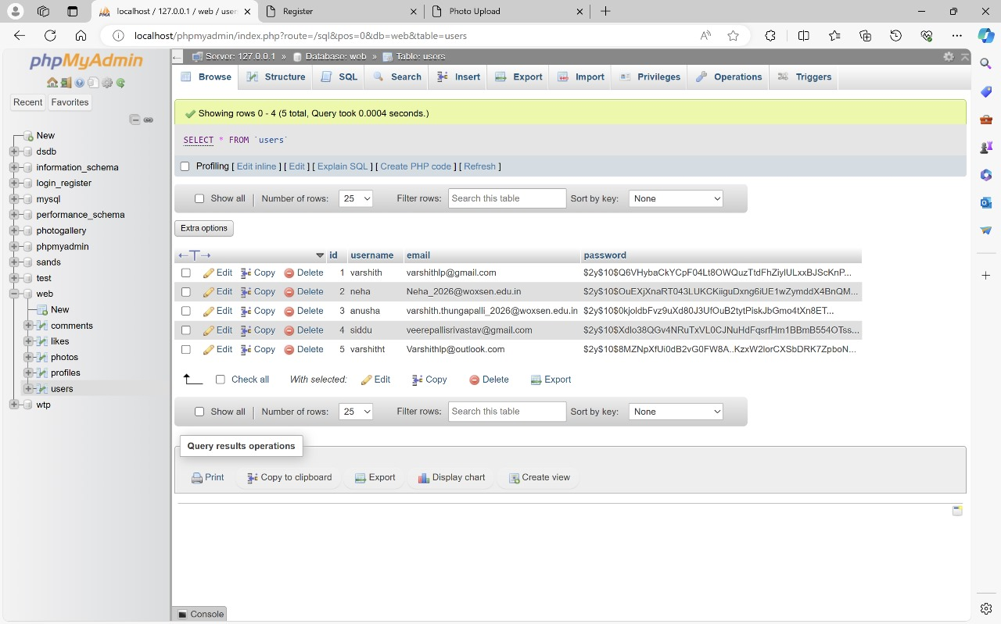

Slide 7
Thankyou

